Slide 1
CoreLab Update
Future Internet Workshop
University of Tokyo/NICT
Aki NAKAO

Slide 2





Research Activity on Future Internet
NVLAB - Network Virtualization Research Lab
(UTokyo and NICT)
AKARI Project
New Generation NW
(NWGN)
Improvement of international competitiveness
Strategic advancement of R&D by collaboration of industry, academia and government
Activities toward NWGN
Re-design of NWGN from scratch
International Competition and Collaboration
Service Platform Advanced Research Center
R&D of NWGN Service Middleware
Global Trend toward NWGN
(FIND, FP7, etc.)
High speed, Diversity
High availability & quality
Secure, Energy saving
Action to unknown problem
US (FIND, etc.)
EU (FP7, etc.)
Next Generation NW
(NXGN)
Social requirements for network
Asia
AKARI Project
Limit of existing technology
- Complexity by
added functions
- Limit of performance
improvement
Collaboration of Industry, Academia and Government
AKARI Project
Data NW
AKARI Project
Internet
AKARI Project
AKARI Project
AKARI Project
AKARI Project
NVLAB - Network Virtualization Research Lab
(UTokyo and NICT)
Cellular
Cellular
PSTN
NVLAB - Network Virtualization Research Lab
(UTokyo and NICT)
NVLAB - Network Virtualization Research Lab
(UTokyo and NICT)
PSTN
NWGN Promotion Forum
NVLAB - Network Virtualization Research Lab
(UTokyo and NICT)
NVLAB - Network Virtualization Research Lab
(UTokyo and NICT)
NVLAB - Network Virtualization Research Lab
(UTokyo and NICT)
New Generation NW
(NWGN)
NVLAB - Network Virtualization Research Lab
(UTokyo and NICT)
New Generation NW
(NWGN)
JGN
JGN2
JGN2plus
Toward the New Testbed
New Generation NW
(NWGN)
Improvement of international competitiveness
New Generation NW
(NWGN)
Improvement of international competitiveness
New Generation NW
(NWGN)
Improvement of international competitiveness
New Generation NW
(NWGN)
Improvement of international competitiveness
New Generation NW
(NWGN)
Improvement of international competitiveness
Improvement of international competitiveness
Strategic advancement of R&D by collaboration of industry, academia and government
Strategic advancement of R&D by collaboration of industry, academia and government
Improvement of international competitiveness
Strategic advancement of R&D by collaboration of industry, academia and government
Strategic advancement of R&D by collaboration of industry, academia and government
Activities toward NWGN
Strategic advancement of R&D by collaboration of industry, academia and government
Activities toward NWGN
Before
Now
Y2010 (Next Generation)
Y2015 (New Generation)
Strategic advancement of R&D by collaboration of industry, academia and government
Activities toward NWGN
Strategic advancement of R&D by collaboration of industry, academia and government
Activities toward NWGN
Re-design of NWGN from scratch
Re-design of NWGN from scratch
International Competition and Collaboration
Activities toward NWGN
International Competition and Collaboration
Current Network
Next Generation Network
(NXGN)
New Generation Network
(NWGN)
Re-design of NWGN from scratch
Activities toward NWGN
Re-design of NWGN from scratch
International Competition and Collaboration
Activities toward NWGN
International Competition and Collaboration
Service Platform Advanced Research Center
R&D of NWGN Service Middleware
Service Platform Advanced Research Center
R&D of NWGN Service Middleware
Re-design of NWGN from scratch
Re-design of NWGN from scratch
International Competition and Collaboration
Service Platform Advanced Research Center
R&D of NWGN Service Middleware
International Competition and Collaboration
Service Platform Advanced Research Center
R&D of NWGN Service Middleware
Re-design of NWGN from scratch
International Competition and Collaboration
Service Platform Advanced Research Center
R&D of NWGN Service Middleware
Service Platform Advanced Research Center
R&D of NWGN Service Middleware
US (FIND, etc.)
Global Trend toward NWGN
(FIND, FP7, etc.)
Service Platform Advanced Research Center
R&D of NWGN Service Middleware
US (FIND, etc.)
Global Trend toward NWGN
(FIND, FP7, etc.)
High speed, Diversity
High availability & quality
Secure, Energy saving
Action to unknown problem
High speed, Diversity
High availability & quality
Secure, Energy saving
Action to unknown problem
US (FIND, etc.)
US (FIND, etc.)
EU (FP7, etc.)
Global Trend toward NWGN
(FIND, FP7, etc.)
EU (FP7, etc.)
Global Trend toward NWGN
(FIND, FP7, etc.)
High speed, Diversity
High availability & quality
Secure, Energy saving
Action to unknown problem
High speed, Diversity
High availability & quality
Secure, Energy saving
Action to unknown problem
US (FIND, etc.)
US (FIND, etc.)
EU (FP7, etc.)
Global Trend toward NWGN
(FIND, FP7, etc.)
EU (FP7, etc.)
Global Trend toward NWGN
(FIND, FP7, etc.)
Next Generation NW
(NXGN)
Next Generation NW
(NXGN)
Asia
Social requirements for network
Asia
Social requirements for network
High speed, Diversity
High availability & quality
Secure, Energy saving
Action to unknown problem
High speed, Diversity
High availability & quality
Secure, Energy saving
Action to unknown problem
US (FIND, etc.)
EU (FP7, etc.)
Global Trend toward NWGN
(FIND, FP7, etc.)
Next Generation NW
(NXGN)
EU (FP7, etc.)
Next Generation NW
(NXGN)
Asia
Social requirements for network
Asia
Social requirements for network
High speed, Diversity
High availability & quality
Secure, Energy saving
Action to unknown problem
Collaboration of Industry, Academia and Government
Collaboration of Industry, Academia and Government
Next Generation NW
(NXGN)
EU (FP7, etc.)
Next Generation NW
(NXGN)
Asia
Social requirements for network
Asia
Data NW
Social requirements for network
Data NW
Internet
Internet
Collaboration of Industry, Academia and Government
Limit of existing technology
- Complexity by
added functions
- Limit of performance
improvement
Collaboration of Industry, Academia and Government
Data NW
Next Generation NW
(NXGN)
Social requirements for network
Limit of existing technology
- Complexity by
added functions
- Limit of performance
improvement
Asia
Data NW
Internet
Internet
Collaboration of Industry, Academia and Government
Limit of existing technology
- Complexity by
added functions
- Limit of performance
improvement
Collaboration of Industry, Academia and Government
Data NW
Limit of existing technology
- Complexity by
added functions
- Limit of performance
improvement
Data NW
Internet
Internet
Limit of existing technology
- Complexity by
added functions
- Limit of performance
improvement
Collaboration of Industry, Academia and Government
Cellular
Limit of existing technology
- Complexity by
added functions
- Limit of performance
improvement
Cellular
PSTN
Data NW
PSTN
Cellular
Internet
Cellular
NWGN Promotion Forum
PSTN
Limit of existing technology
- Complexity by
added functions
- Limit of performance
improvement
NWGN Promotion Forum
PSTN
Cellular
Cellular
PSTN
Cellular
PSTN
Cellular
NWGN Promotion Forum
PSTN
NWGN Promotion Forum
PSTN
Cellular
Cellular
PSTN
Cellular
PSTN
Cellular
NWGN Promotion Forum
JGN
NWGN Promotion Forum
JGN
JGN2
JGN2
JGN2plus
JGN2plus
Toward the New Testbed
PSTN
Toward the New Testbed
PSTN
Cellular
Cellular
PSTN
NWGN Promotion Forum
JGN
JGN
JGN2
JGN2
JGN2plus
JGN2plus
Toward the New Testbed
PSTN
Toward the New Testbed
JGN
JGN
JGN2
JGN2
JGN2plus
JGN2plus
Toward the New Testbed
Toward the New Testbed
JGN
JGN2
JGN2plus
Toward the New Testbed
Before
Before
Now
Now
Y2010 (Next Generation)
Y2010 (Next Generation)
Y2015 (New Generation)
Y2015 (New Generation)
Before
Before
Now
Now
Y2010 (Next Generation)
Y2010 (Next Generation)
Y2015 (New Generation)
Y2015 (New Generation)
Before
Before
Now
Now
Y2010 (Next Generation)
Y2010 (Next Generation)
Y2015 (New Generation)
Current Network
Y2015 (New Generation)
Current Network
Next Generation Network
(NXGN)
Next Generation Network
(NXGN)
New Generation Network
(NWGN)
Before
Now
Y2010 (Next Generation)
New Generation Network
(NWGN)
Current Network
Y2015 (New Generation)
Current Network
Next Generation Network
(NXGN)
Next Generation Network
(NXGN)
New Generation Network
(NWGN)
New Generation Network
(NWGN)
Current Network
Current Network
Next Generation Network
(NXGN)
Next Generation Network
(NXGN)
New Generation Network
(NWGN)
New Generation Network
(NWGN)
Current Network
Next Generation Network
(NXGN)
New Generation Network
(NWGN)

Slide 3

Overview of Research on NwGN
R&D for defining and designing future Internet
Network Virtualization Research Lab
(UTokyo+NICT)
CoreLab (UTokyo+NICT)
AKARI Architecture Design Project
(NICT+Universities)
SPARC Service Middleware Project(NICT)
JGN2Plus Test-bed(NICT)
Today’s Talk
Network Vitualization as Architecture
and its applications !!

Slide 4
Network Virtualization as Architecture
Isolate physical network resources through virtualization and hold multiple independent and programmable logical networks
  Implement multiple network architectures and services on top of isolated logical networks
    Meta-architecture to enable multiple architectures
    Testbed technology for a new architecture
  Operate multiple existing architectures
    Dynamic and secure logical networks
    User- and application specific logical networks
    New business models for carriers and operators

Slide 5
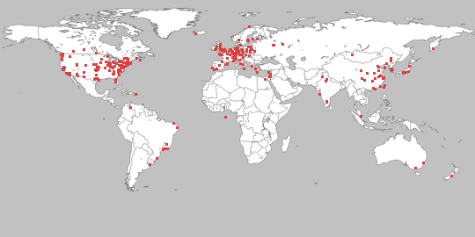

A Step Towards Reality: PlanetLab Enhancement
The largest and most popular overlay network test-bed
Currently consists of 900+ nodes at 450+ sites
800+ Projects/ 1000+ Researchers
  180+ high-level academic publications enabled

Slide 6
What have we learned from PlanetLab?
Concept
  Slice-based experimental facility
“Slice” Mechanism
  Resource Isolation through Virtualization
Management Framework
  Node : Physical Machine
  Sliver : Virtual Machine
  Slice : A collection of Virtual Machines
  RSpec: Resource Description
  PLC: Central Management Servers

Slide 7
Limitations in PlanetLab
Flexibility is sacrificed over Scalability/Performance
  Sliver : Container-based Resource Isolation
  Shares crucial resources
    Single kernel (Linux with VServer patch)
    Network stack and modules (NAT, Firewall, etc)
    Network resources (IP address and ports)
    Vnet (virtual network device ; need work for multi-homing)
  Cannot run arbitrary kernel/network stack & modules

Slide 8
Design Principle for a New Test-bed
Performance
  Network I/O
Scalability
  The number of slices
Isolation
  Resource must be isolated per slice
Flexibility
  Arbitrary kernel/network stacks/resources

Slide 9
CoreLab Update
New
Design
  Sliver VEE : Hosted VMM + Resource Container
  Introducing Flexibility in execution environment
  VM Disk Image Transfer : Multipath & Caching
  Network Configuration : Multihoming
  Management Tools: Reuse PlanetLab’s design
  Federation with PLC, OneLab2, VINI, Max, G-Lab
Comparison Chart | PlanetLab | CoreLab
Sliver | Resource Container | Hosted VMM
Kernel | Shared | Separated
Guest OS | Various Linux Distros | Any OSes
IP & Port | Shared | Shared (managed)
Privileged System Calls | Shared | Isolated

Slide 10
VEE Candidate for Sliver Implementation
Supported by CoreLab
Supported by CoreLab
Manager
Apps
apps
Apps
Apps
Apps
Apps
MngOS
GuestOS
GuestOS
GuestOS
GuestOS
Apps
VE
VE
VM
VM
VM
Apps
VM
VM
HostOS
VMM
HostOS
Hardware
Hardware
Hardware
Resource Container
Hypervisor-Based
Host-Based
Design Principles | Performance | Scalability | Security Isolation | Performance Isolation | Flexibility | Code Reusability
Resource Container | + | + |  | + | -
Hyper- visor | + |  | + | + | + | -
Hosted- VMM | ? | ? | + | ? | + | +
advantageous
disadvantageous
room for improvement

Slide 11
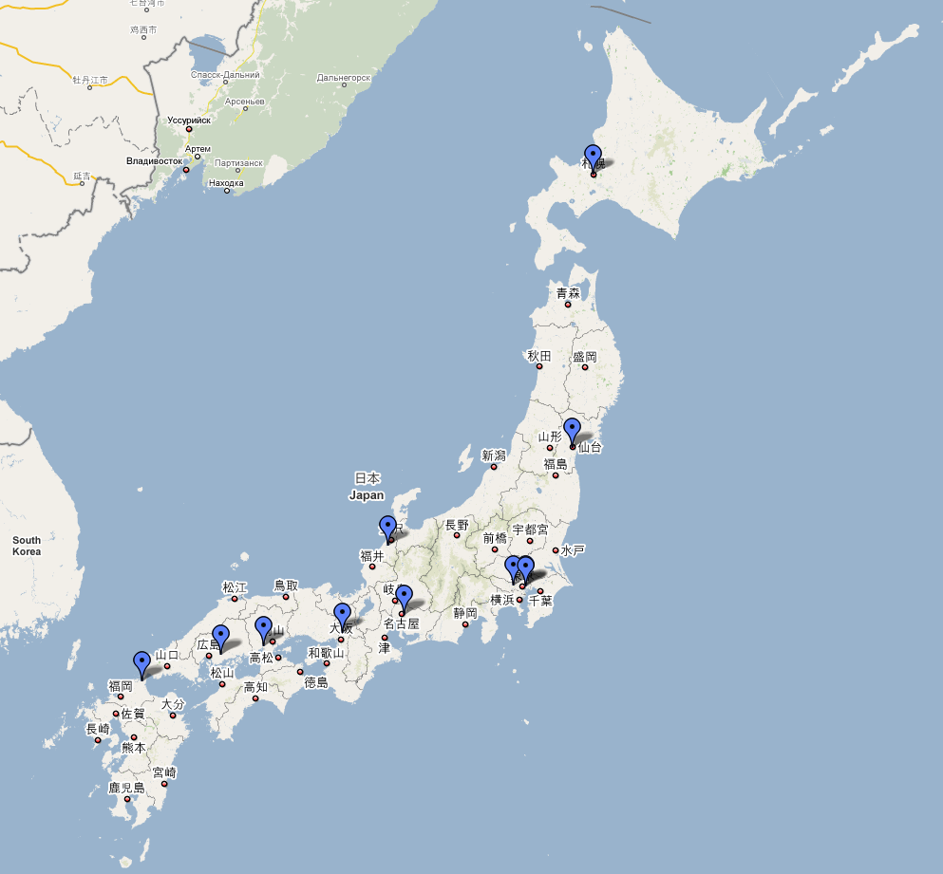


CoreLab Deployment (on-going)
Phase1 : 12 Sites over JGN2Plus + SINET + others
Phase1.1: Support Various Virtualization Technologies
Phase1.2: More nodes deployed in Japan (+12)
Phase2 : Extend to Asian Region
HP DL 580 (4U)
Intel Xeon 16-core (quad 4-core)
128GB (Max 256GB) memory
300GB RAID5
(accommodate up to 254 slices)

Slide 12
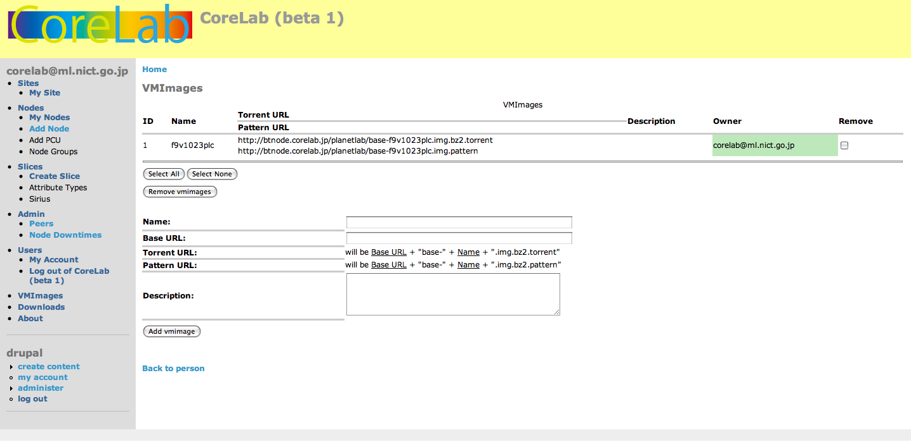
CoreLab : In Action…
http://www.corelab.jp

Slide 13
Phase 1.1 Update
New Features
  Framework to support various virtualizations
    OpenVZ (Resource Containers)
    KVM (Hosted Virtualization)
    Xen (Hypervisor) (planned…)
  Supporting various OS types
    Linux multi-kernel support
    Windows (para virtualization coming soon…)
  Network namespace reservation
    Slice-wide namespace (port) reservation
  Resource control
    Cgroups, TC, etc
  Node Logging
    Keeping track of events from nodes

Slide 14
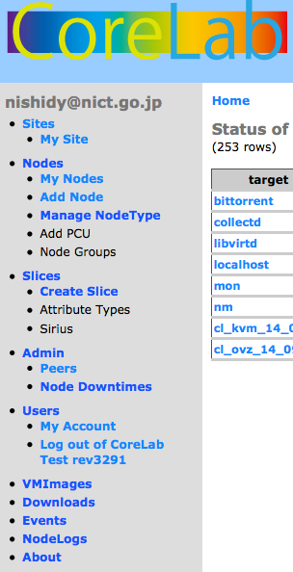
CoreLab Admin Interface (Update)
Manage Node Type
OVZ, KVM,
Things not shown here….
Resource Control
Slice-Wide Namespace Reservation
VM Images
Linux Distros, Windows
Node Logs / Events
Notifications & Errors

Slide 15
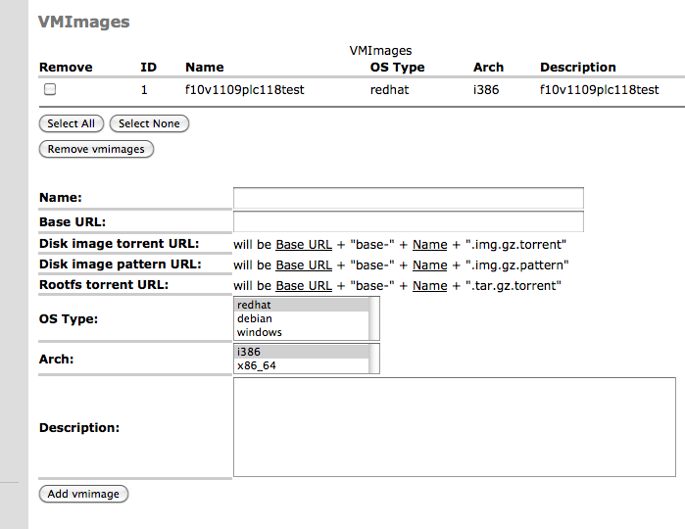
Registering/Selecting VM Images
Fedora10 (RedHat Type/ i386)
We can add arbitrary VM images to disseminate to nodes…

Slide 16
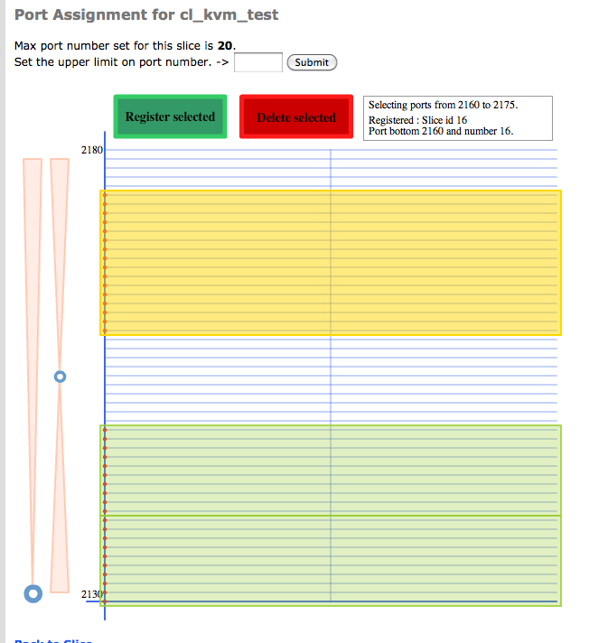
Slice-wide Port Reservation
Flash Interface to reserve
Port range for a slice
Port Range to be assigned
To a new KVM slice…
Port Range already assigned
to the other slices

Slide 17
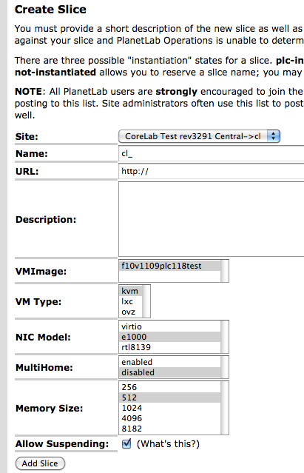
Creating A Slice…
VM Image
Arbitrary OS images registered
VM Type
KVM, LXC, OVZ, and more coming
NIC Model
Vanilla, Para-Virtualized Drivers
Multihome
SINET, JGN2Plus, or both
Memory Size
256, 512, 1024, 4096, 8192 MB
Suspend Feature
Suspend the slice when idol

Slide 18
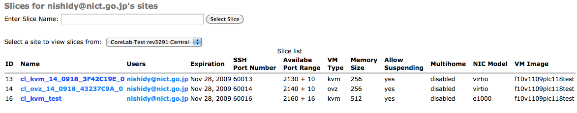
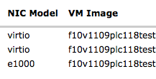
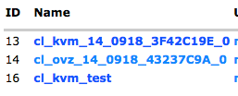

Slices in Action…
In this example,
there are three slices running in our test CoreLab PLC
One OVZ and Two KVM slices

Slide 19
Conclusions
Network Virtualization is one of the most important visions
Enabling infrastructure for NetVirt is already taking place
Applications of network virtualization are very important..

Slide 20





Contact Information
Network Virtualization is one of the key technologies for proceeding further in defining NwGN architecture(s)
We are turning this vision into reality..
Net-Virtualization Research Lab Contact: nakao@iii.u-tokyo.ac.jp
nv-lab@ml.nict.go.jp
http://www.nvlab.org

